Slide 1

0F6CB6
HomeAway: Homie AI

Slide 2

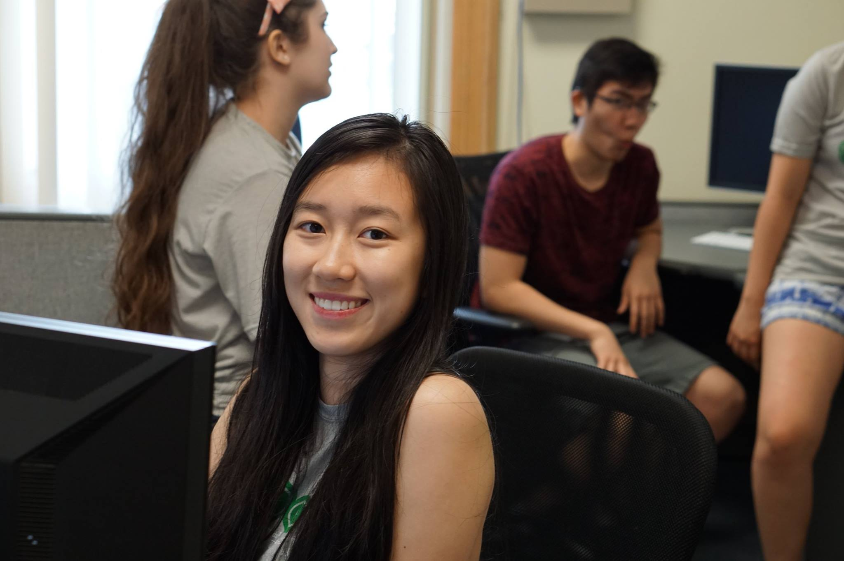

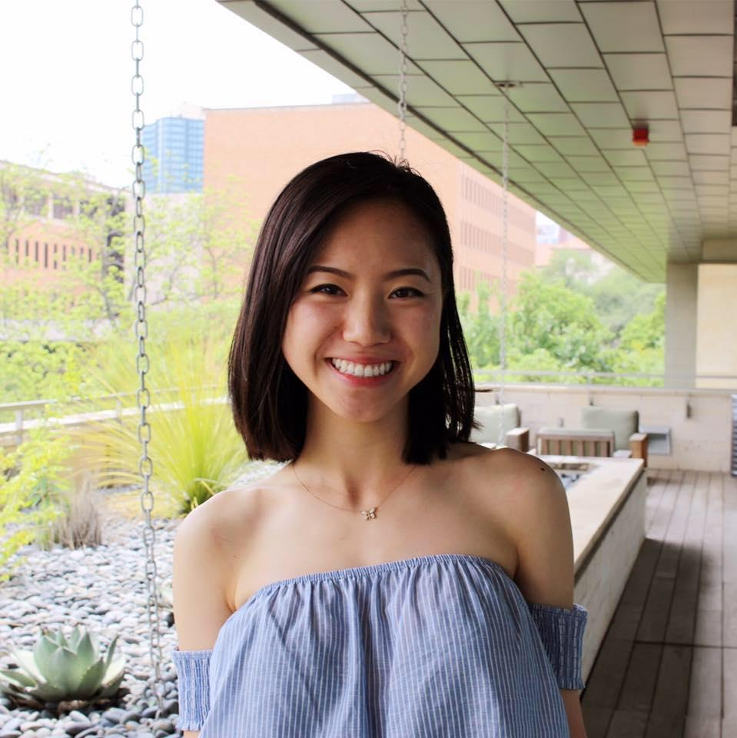

Our Team
Texas Convergent
Misha Shaposhnikov
Estella
Xin
Luca
Tomescu
Genny
Li
Shaayaan
Sayed
Notes:
everyone

Slide 3
Customers must “click and click and click” through pages of listings that fail to address their preferences.
Notes:
Genny

Slide 4
Traveler Preferences
85%
33%
of travelers want their preferences saved and shown first
of travelers prioritize listing relevance over price
Notes:
Genny

Slide 5
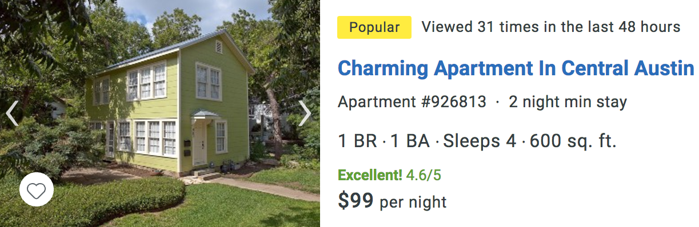
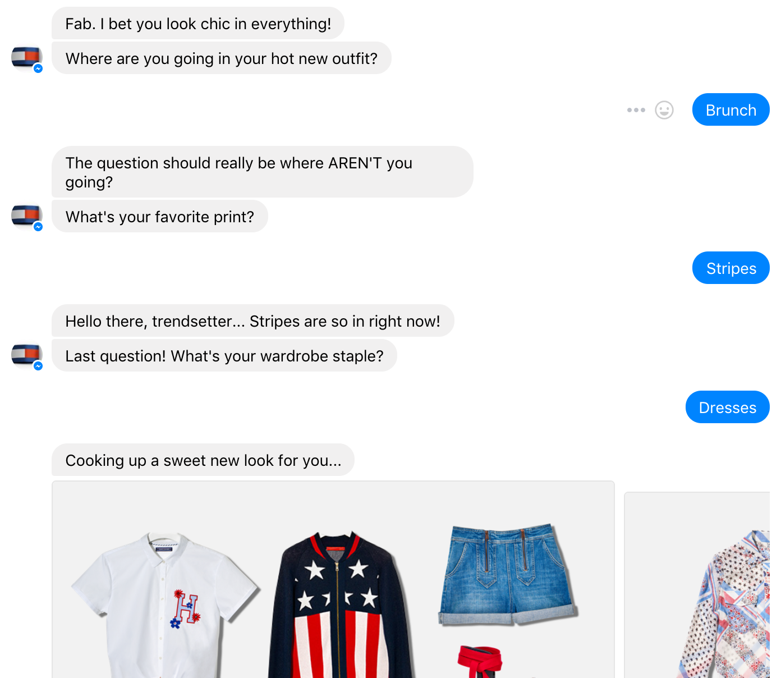
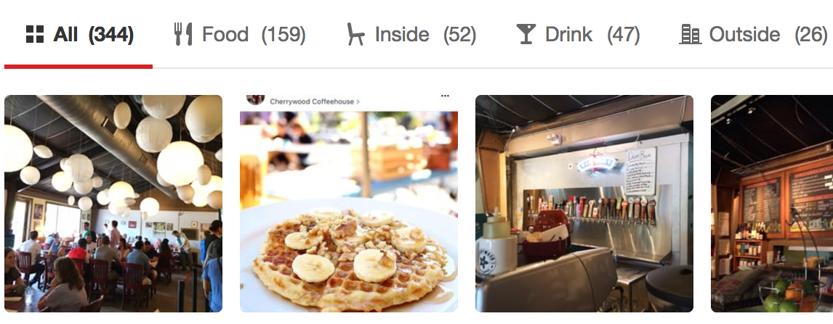
Our Solution
AI Photo Recognition
Optimize Browsing Experience
Homie Chatbot
Notes:
Genny

Slide 6
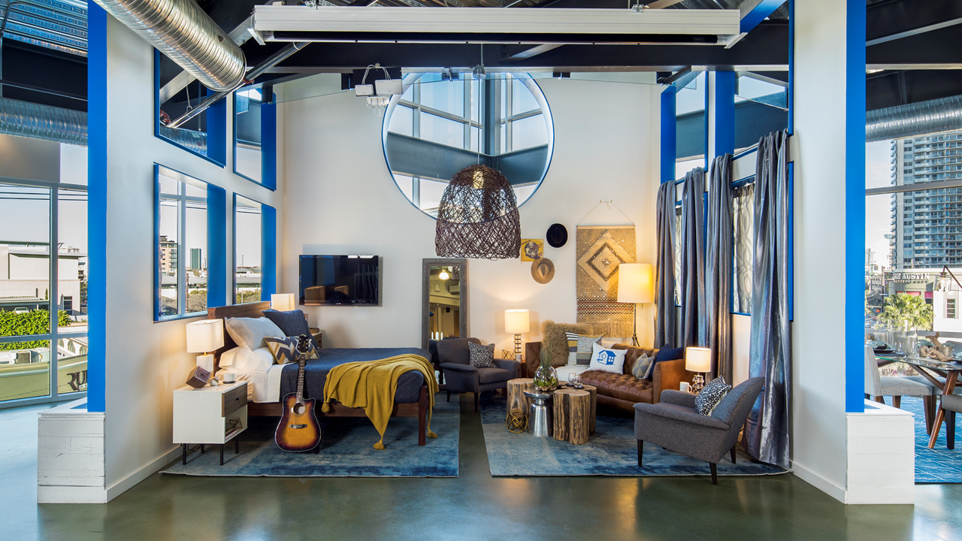
Photo Intelligence

Slide 7
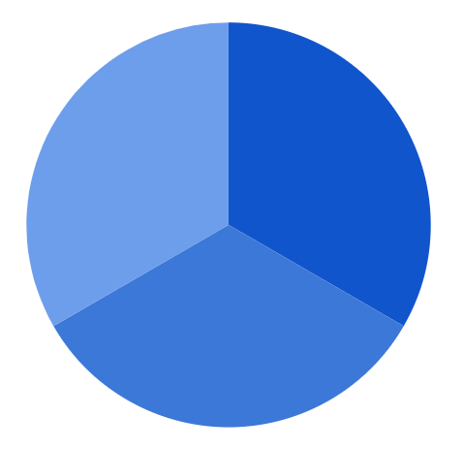



Images in Listings
Entertainment
Price
Images
Amenities
Location
Vibe

Slide 8
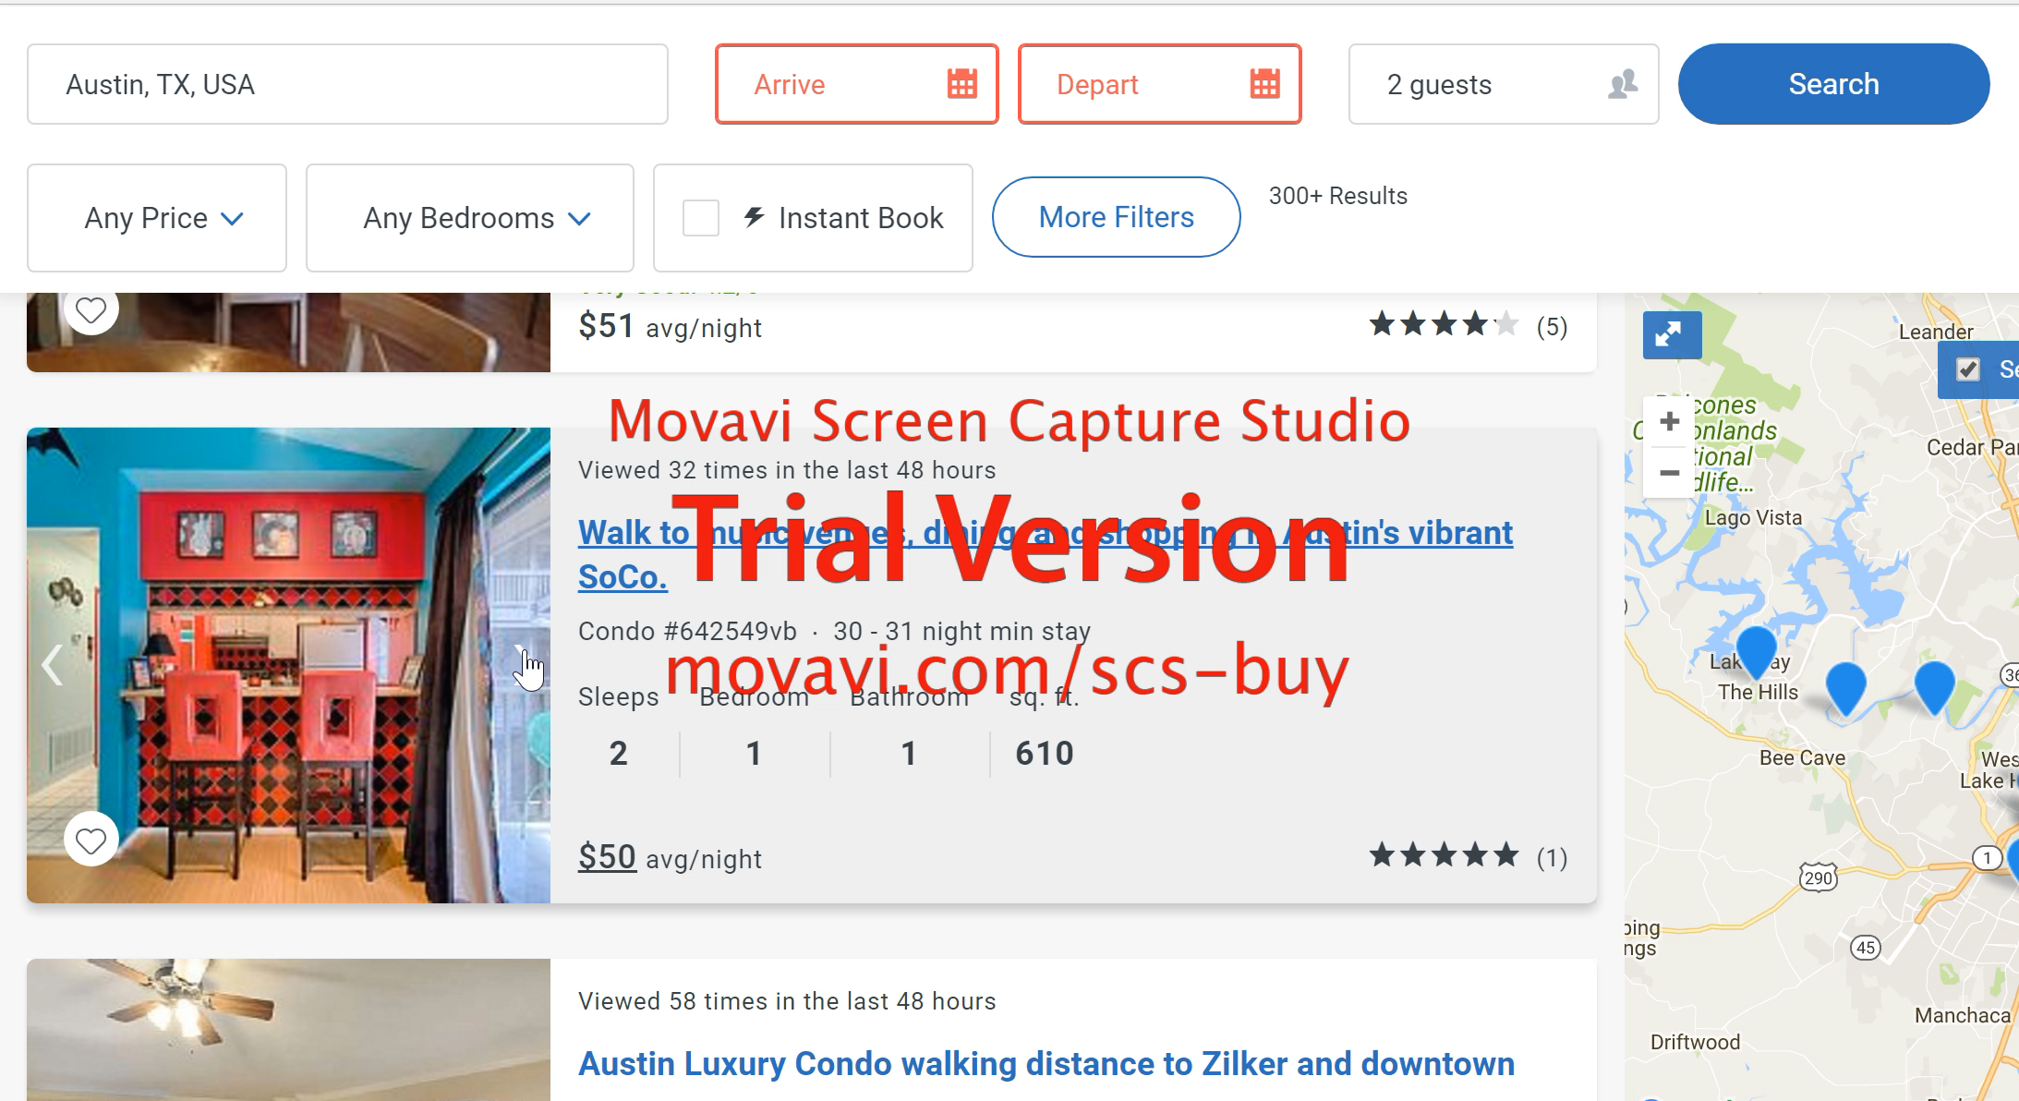
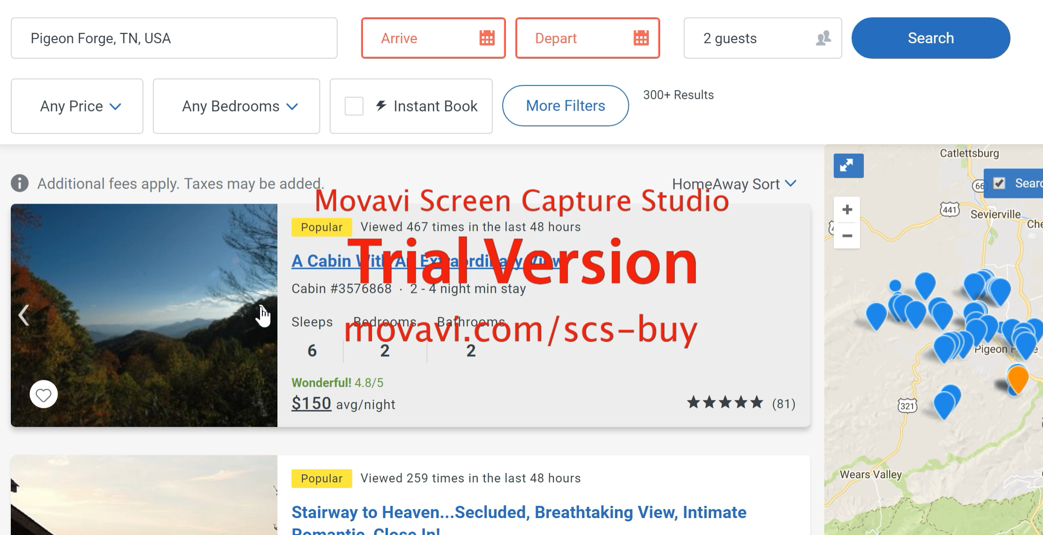
Thumbnail Optimization
Without optimization
With optimization
Notes:
Estella -
Without photo intelligence, this is how the thumbnail slideshow next to a listing looks like. A customer has to sift through so many irrelevant photos before seeing images of the inside of the home. Our tool tags photos based on home features and then we can optimize which photos show up first in the thumbails of listings. This decreases the amount of clicks it takes a user to see what they want, increasing the probability of a customer booking
With optimization, here is an example of what an ideal thumbnail of a listing would look like. Each consecutive image shows a distinct feature of the house including the kitchen, the bedroom, the living area, the exterior, and amenities. These are what the customer cares about most and our tool allows us to show them what they want.
Shay does explanation
Shay do transition

Slide 9
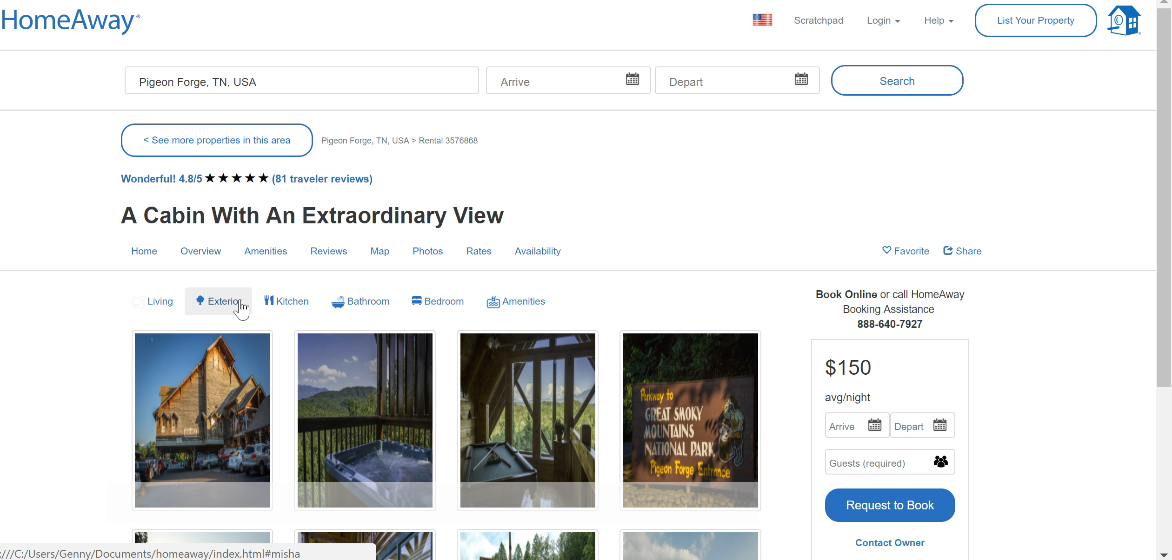
Thumbnail Optimization
Without optimization
With optimization
Notes:
Estella -
Without photo intelligence, this is how the thumbnail slideshow next to a listing looks like. A customer has to sift through so many irrelevant photos before seeing images of the inside of the home. Our tool tags photos based on home features and then we can optimize which photos show up first in the thumbails of listings. This decreases the amount of clicks it takes a user to see what they want, increasing the probability of a customer booking
With optimization, here is an example of what an ideal thumbnail of a listing would look like. Each consecutive image shows a distinct feature of the house including the kitchen, the bedroom, the living area, the exterior, and amenities. These are what the customer cares about most and our tool allows us to show them what they want.
Shay does explanation
Shay do transition

Slide 10
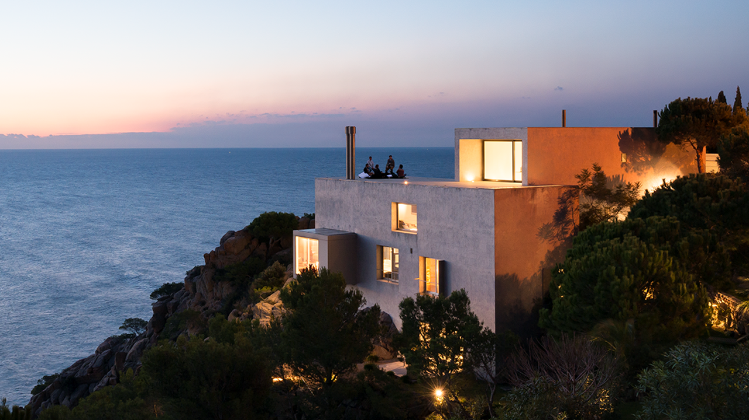
Homie Chatbot

Slide 11


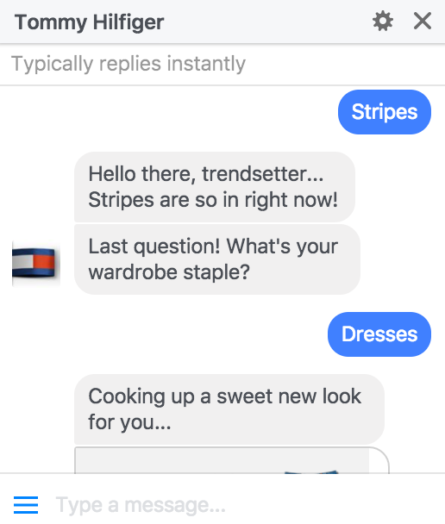


Rise of commerce bots
1.2B monthly users
Customers use social media for inspiration
30,000 bots used by H&M, Sephora, Tommy Hilfiger
Parents value children’s input
Personalization through AI
Growing trend
Leverage chat applications
52%
87%
Notes:
Shay
· Hone in on customer preferences through conversation
· Provide exceptional service
· 73% percent of consumers expect customer service to be easier and more convenient than it is, and 61 percent want it to be faster. And 44%of consumers admit to taking to social media channels to vent about poor service.
· 30,000 bots by H&M, Sephora, Tommy Hilfiger
· Eliminate clicks before booking
· Increase customer engagement
· 1.2B active monthly users on Messenger

Slide 12
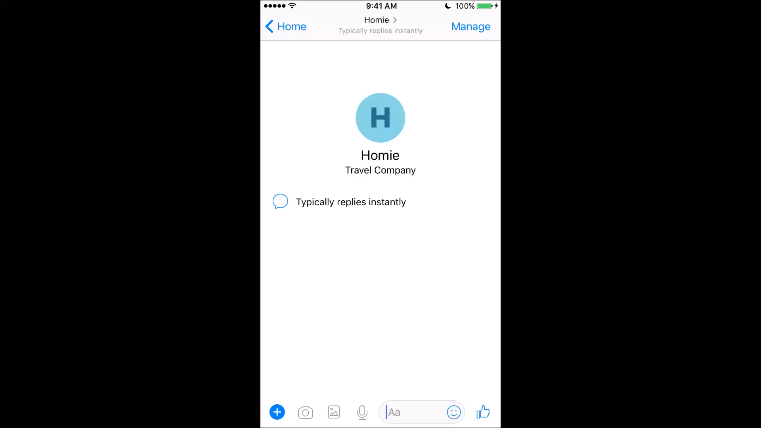
DEMO
Notes:
Misha

Slide 13








Group Planning
Notes:
Luca

Slide 14

Looking Forward
Notes:
Luca

Slide 15



Future Verticals
Photograph Ratings
Messaging Platforms
Virtual Realtor
Owners learn to take more marketable photos
Expand to other services for international reach
Sentiment analysis and tone of voice recognition
Notes:
Luca
Virtual Realtor: emotional recognition, tone of voice
Photograph rating/recommendation for renters
Expand to different messenger services

Slide 16

Our Goal
Provide a Six-Star Experience
Notes:
Luca

Slide 17

Q&A
https://www.facebook.com/HomeAwayHomie/

